Slide 1



Saving Lives through Clean Water
Notes:
Water Survival Box is a humanitarian project of Chelwood Bridge Rotary Club in Somerset.
Formed in 2006 it has now sent 0ver 19000 boxes to 74 disasters in 34 countries

Slide 2
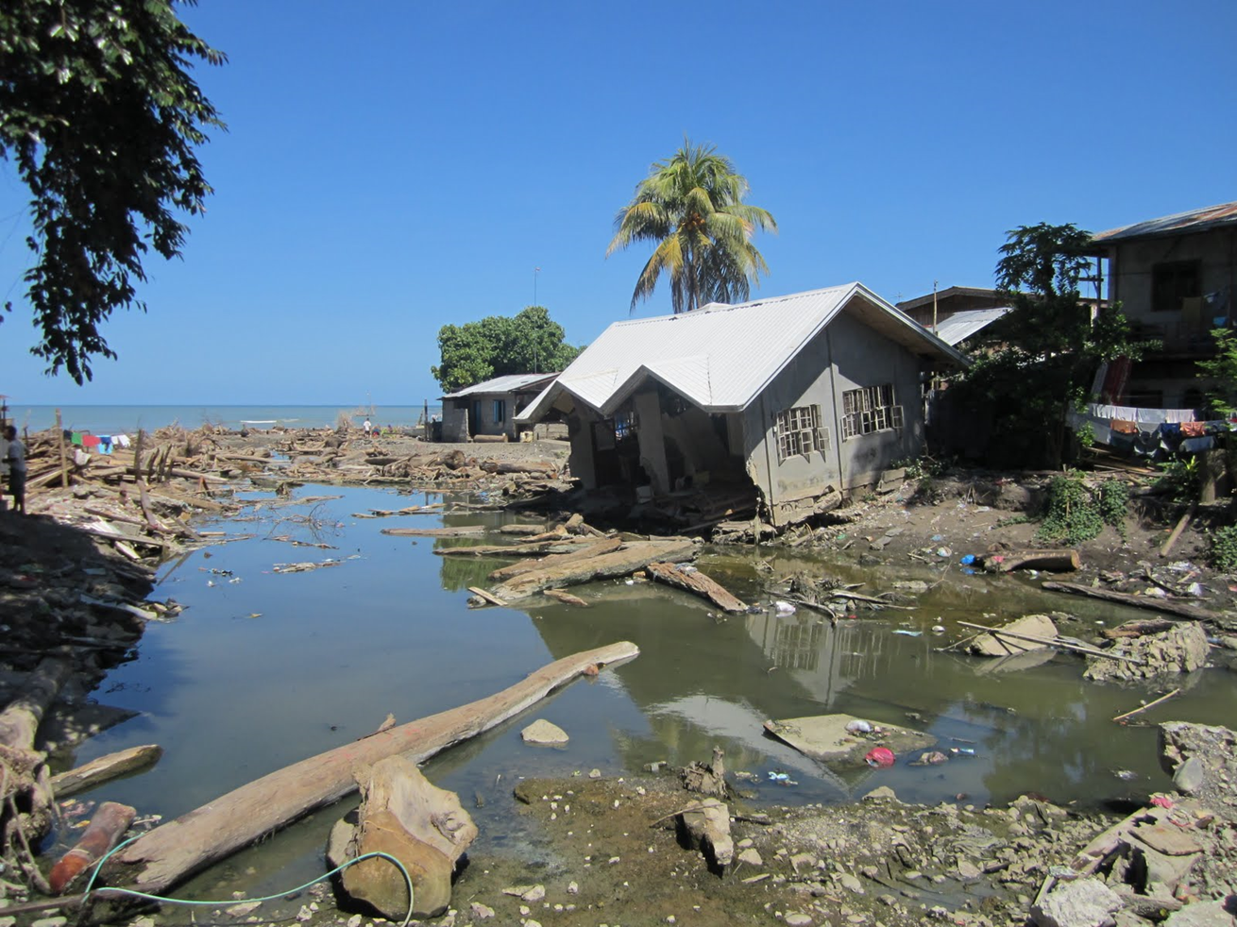
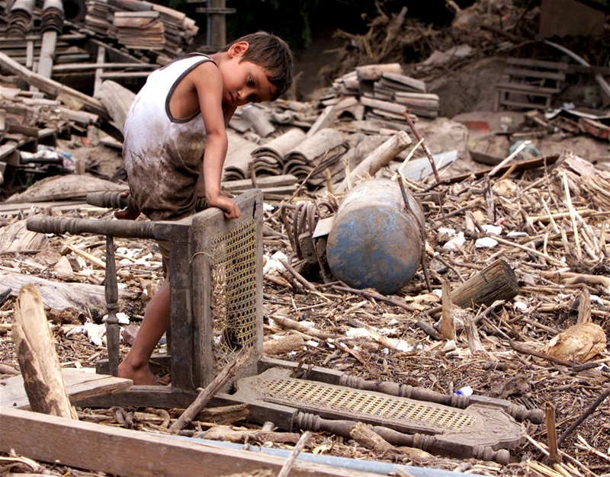
IMAGINE……….
Notes:
being left with no home,
no safe water to drink,
and none of your belongings

Slide 3
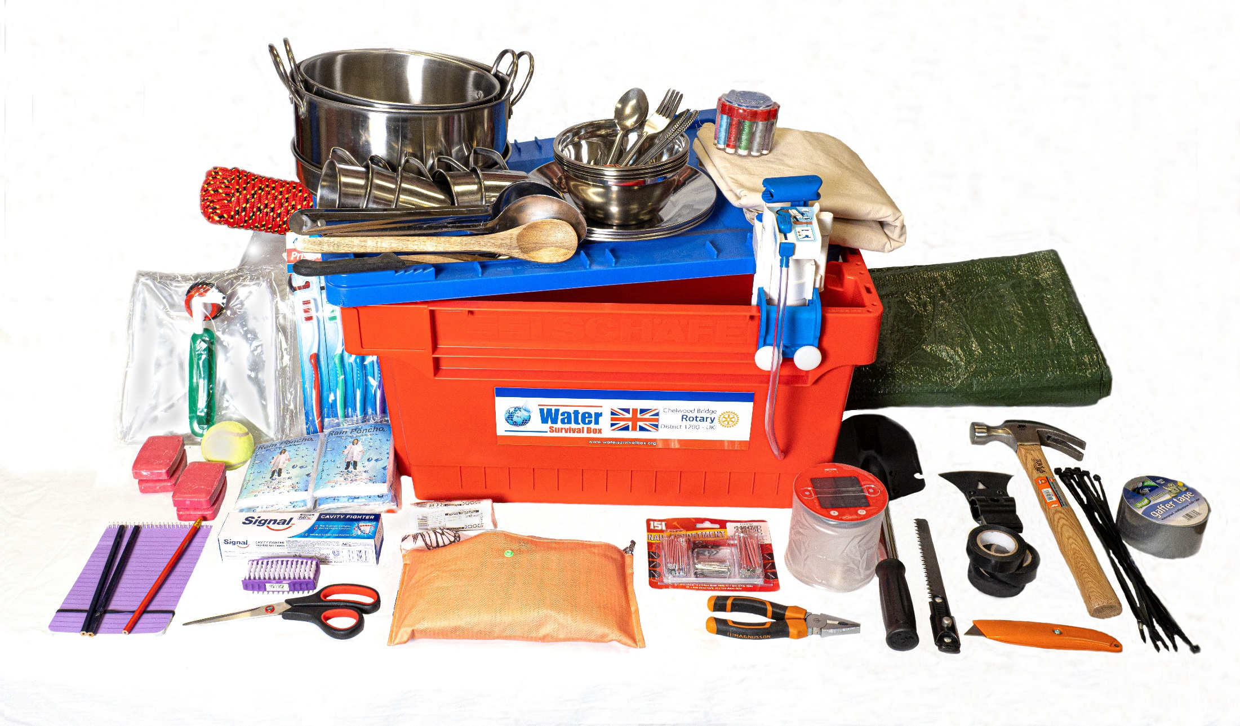
WATER-SURVIVAL BOX – WHAT IS IT?
Notes:
show the whole thing before moving on to the filter on next slide

Slide 4
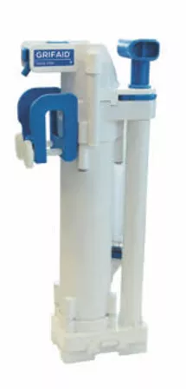
GRIFAID FAMILY FILTER
90 Litres per hour
No chemicals
Up to 200,000 litres safe water
Simple cleaning built in
Cost under £40

Slide 5
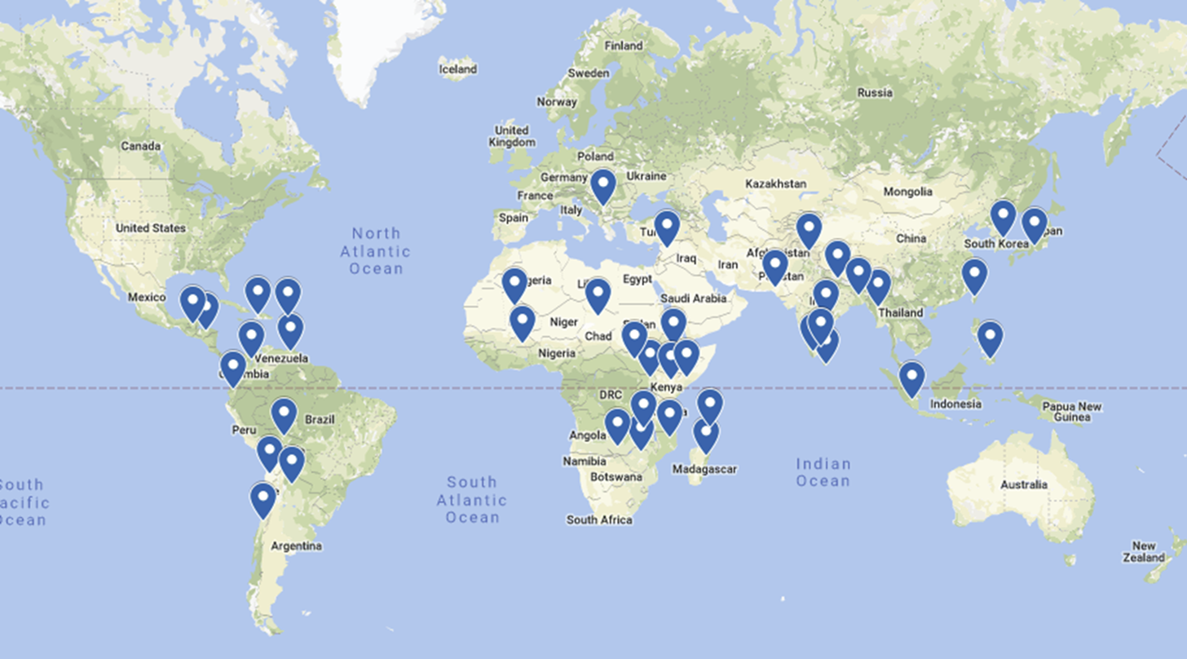
DISTRIBUTIONS
Notes:
Shows the countries we have sent boxes to. I usually mention the patterns. Fault lines in Caribbean and S America, hurricanes in Caribbean. Flooding in African mostly. Pacific rim of fire – earthquakes, monsoon and typhoons.

Slide 6
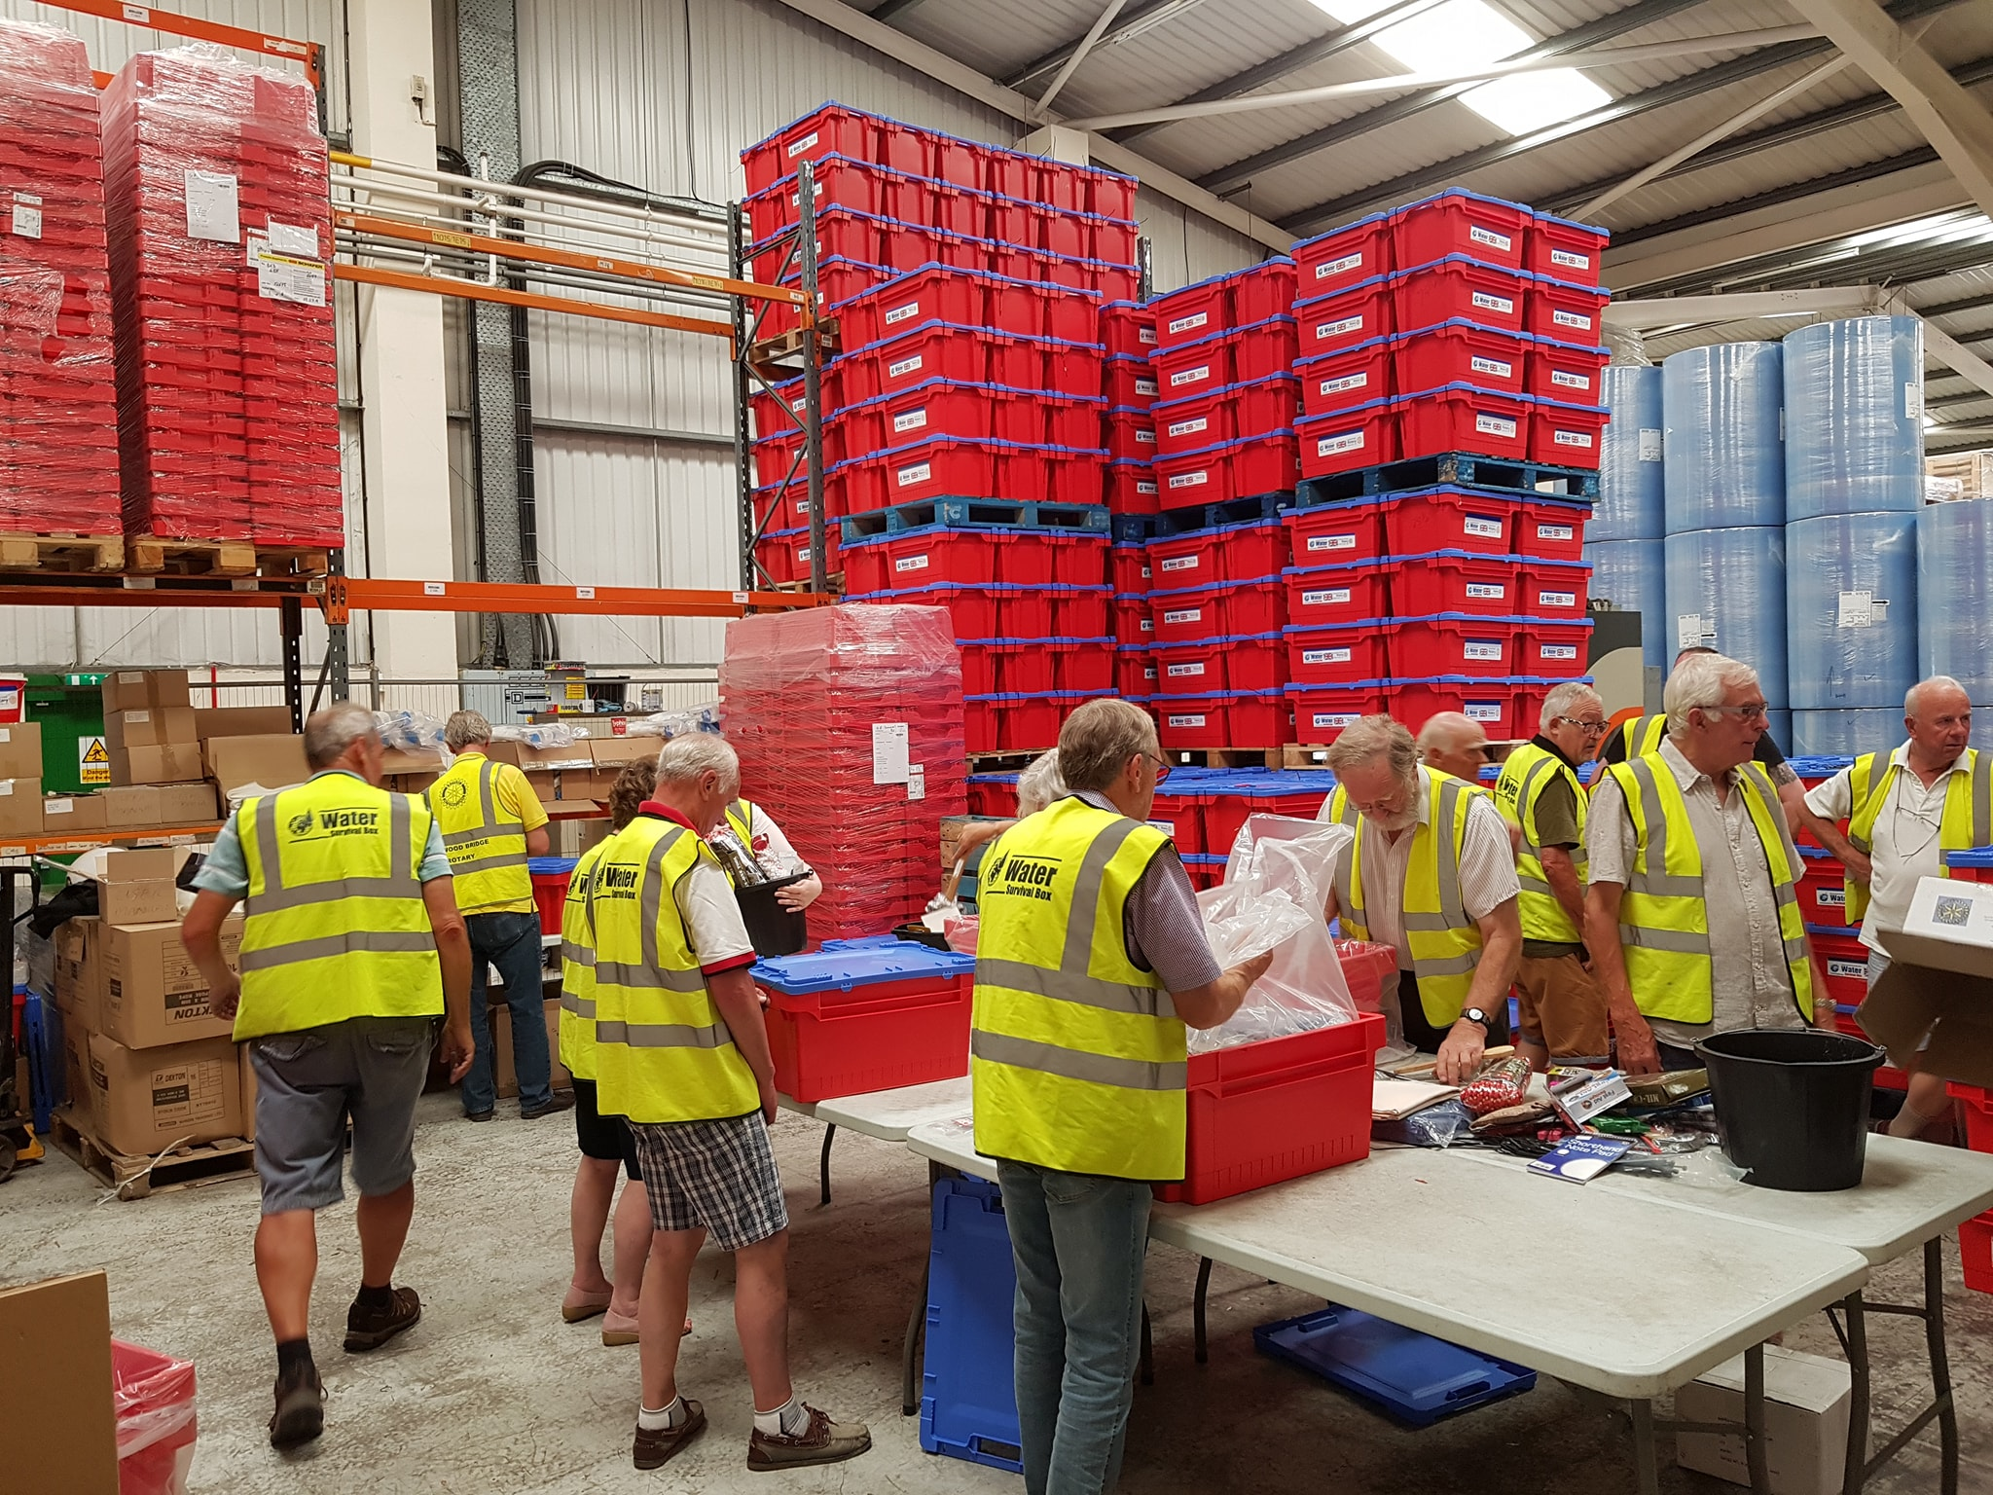
PACKING AT OUR DEPOT
Notes:
I then move on to the depot. Talk about packing, who helps us and the support from Parker Transport. I have recently been explaining an improved process to keep people safe and distanced

Slide 7
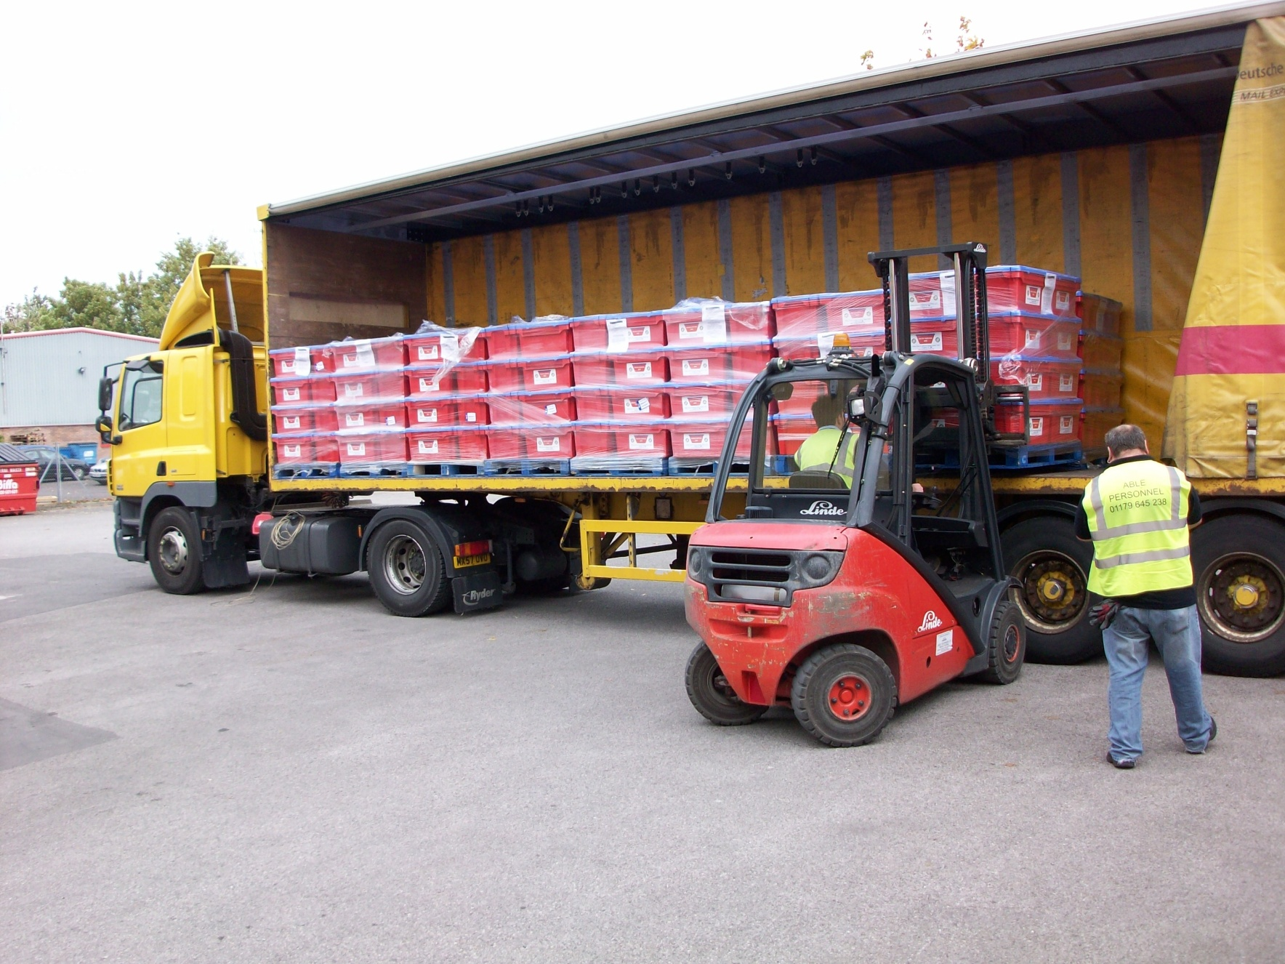
DESPATCH
DESPATCH
Notes:
DHL collect the boxes from our depot

Slide 8
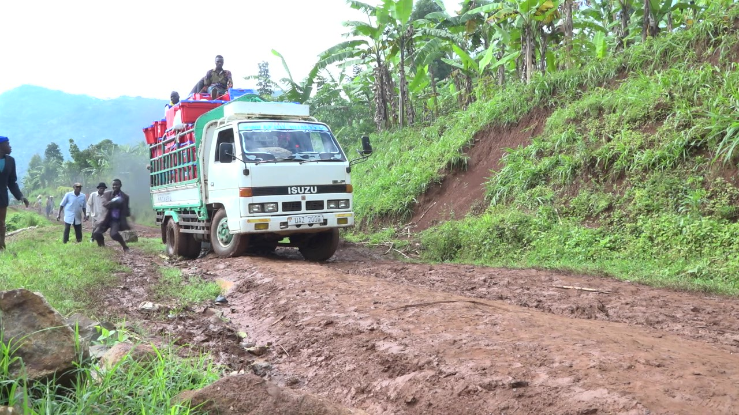
DELIVERY
Notes:
I like to speak bout the end delivery and this slide and the next 2 show different ways – making logistics critical and so varied

Slide 9
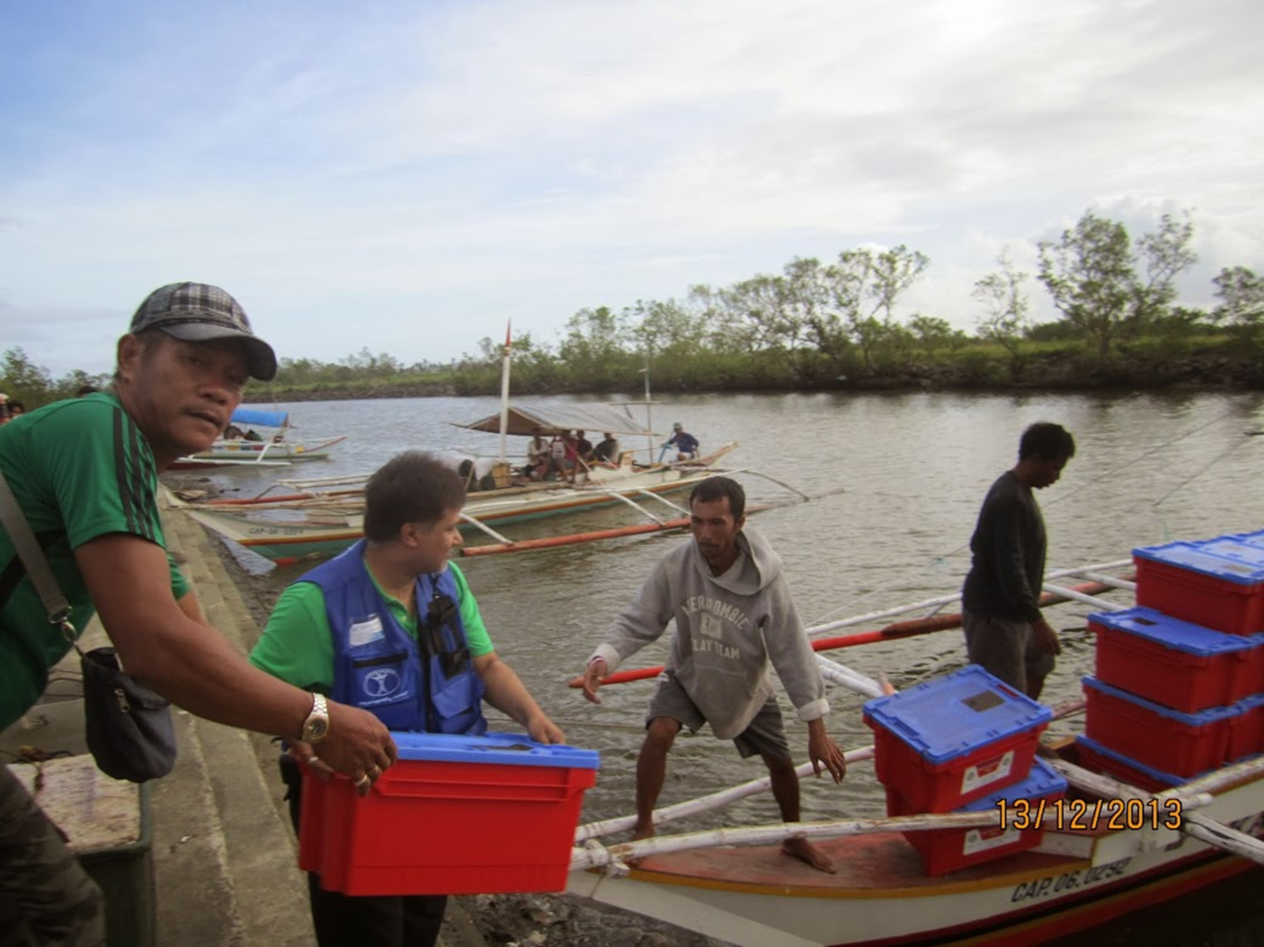
DELIVERY

Slide 10
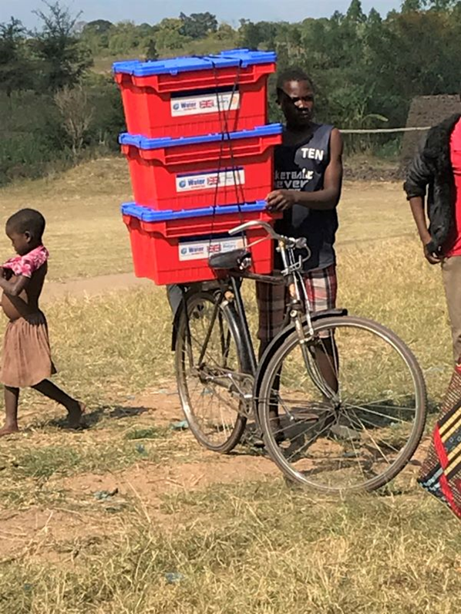

Slide 11
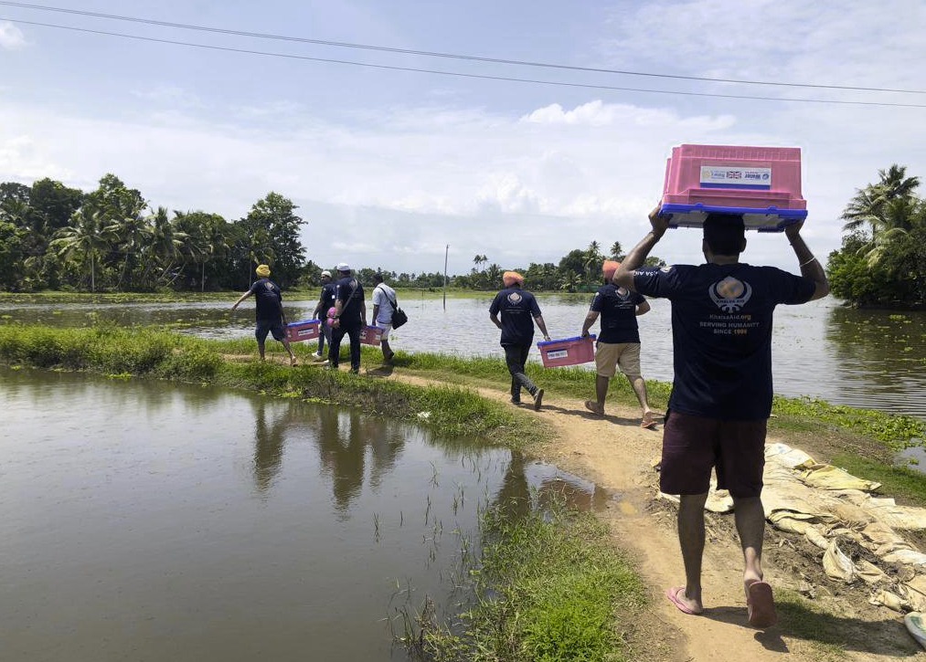
NEPAL EARTHQUAKE
Notes:
Kerala 2018

Slide 12
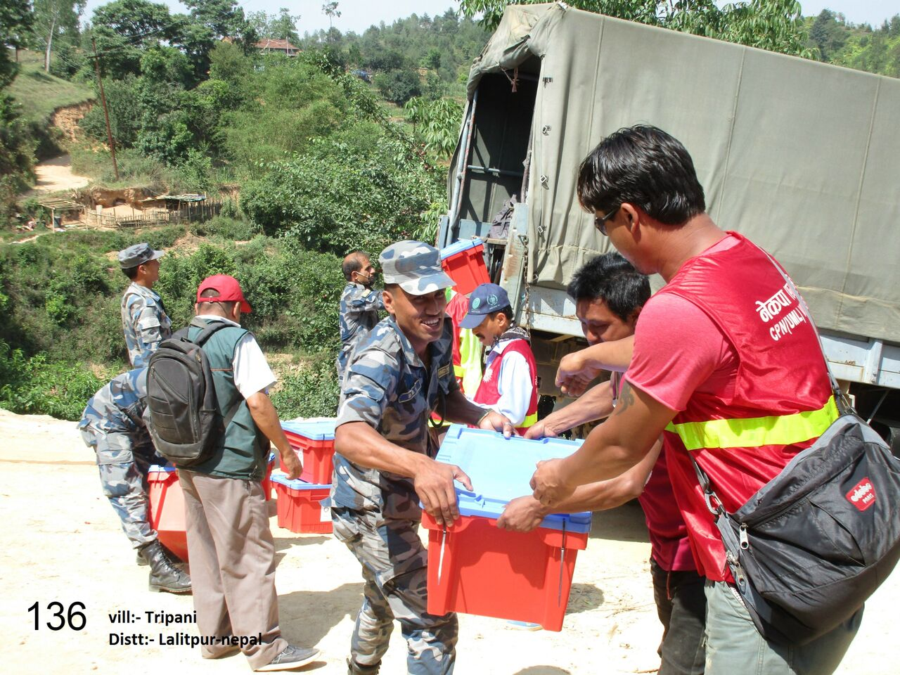
NEPAL EARTHQUAKE 500
300 boxes sent
Water Projects as follow up
Notes:
Two very severe earthquakes in Nepal. Here Humanity First and their colleagues helped us get 500 boxes in before the government put import duty back on and we were asked to pay another £10000 for the next shipment. As we had raised about £20000 we decided not to send boxes but spent the money on sanitation projects in two schools. Keeping within our values of spending cash received on the country it was meant for

Slide 13
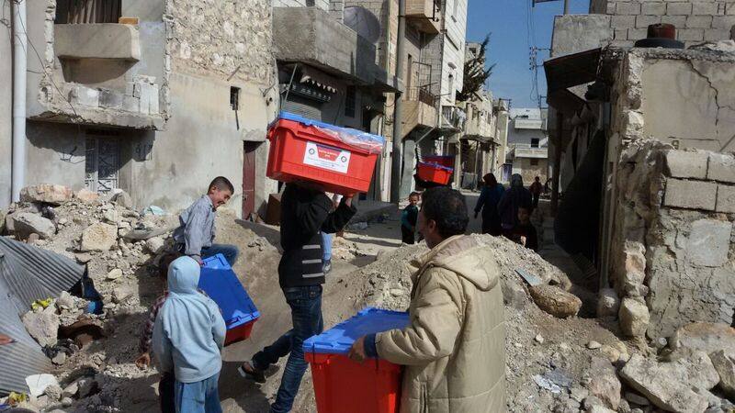
SYRIA – 600 BOXES
Notes:
We have sent several consignments to Syria , 200 this year, 600 in all. These are from the first batch to Aleppo

Slide 14
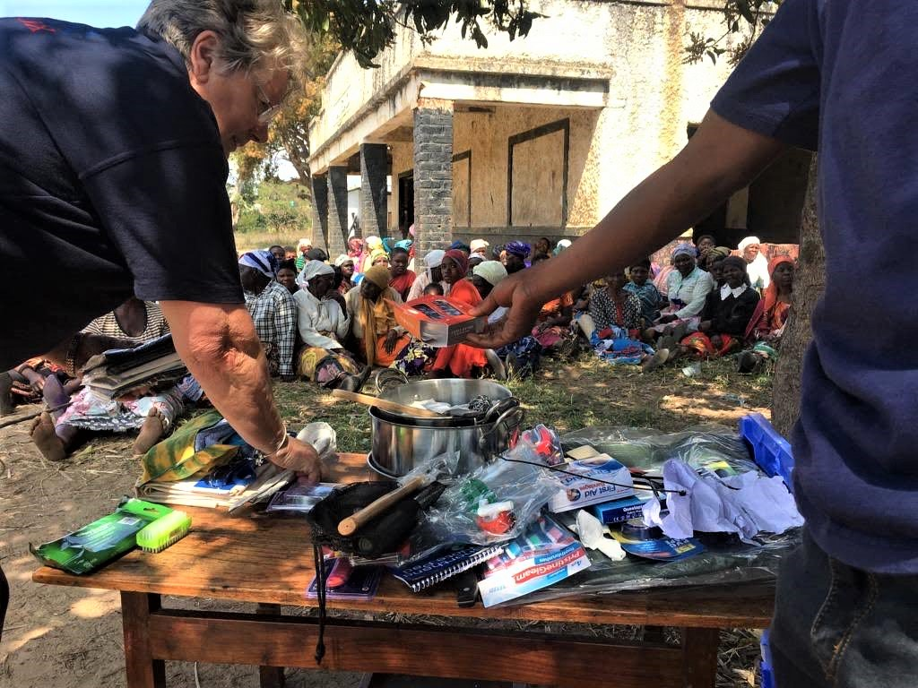
MALAWI CYCLONE IDAI 500 BOXES
Notes:
Assistant Governor and fellow trustee Dot Cretney was invited by Khalsa Aid to travel with them for the distributing in Malawi and brought back a lot of good feedback to help us continue to improve the contents

Slide 15
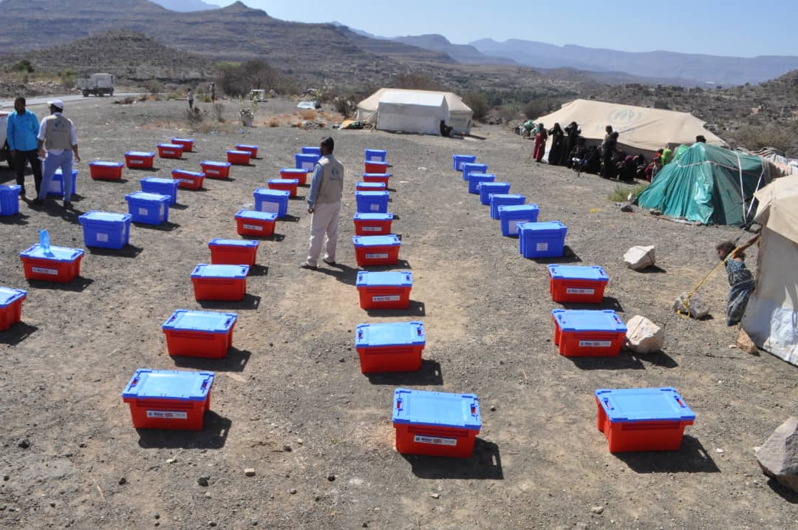
YEMEN 500 BOXES
Notes:
This was in February 2021 – since then a further 200 on their way and a further 200 to Syria. This was a joint effort with Aquabox. – you can see them together here. These as well as Yemen go by sea because there is no air facilities

Slide 16
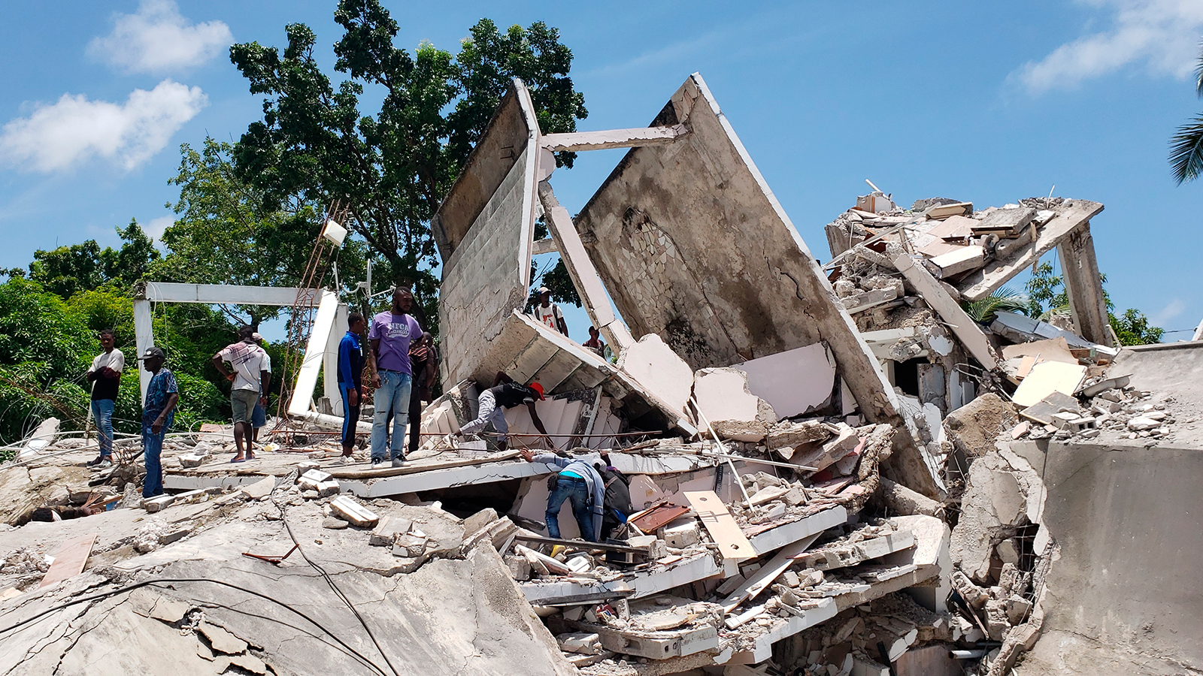
HAITI 2021 AND 2022
Notes:
The latest is that because of the unsafe situation in Haiti we are having to bide out time in getting boxes out to them. Several agencies have refused to send staff in because of the dangers. Looting, violence over any aid is rife.

Slide 17
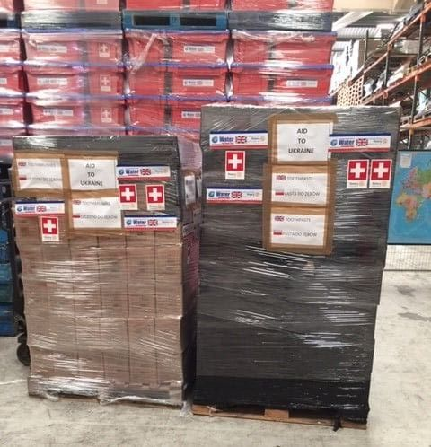
UKRAINE 2022

Slide 18
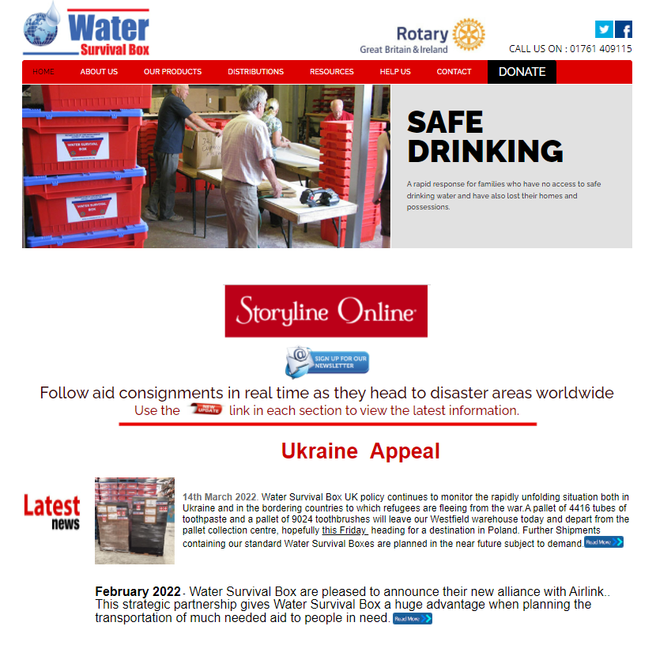
Notes:
Our website has changed recently and we now provide dynamic news updates on our activity. On the site are downloads of materials for use in public events, reports of our distributions and a donations page

Slide 19
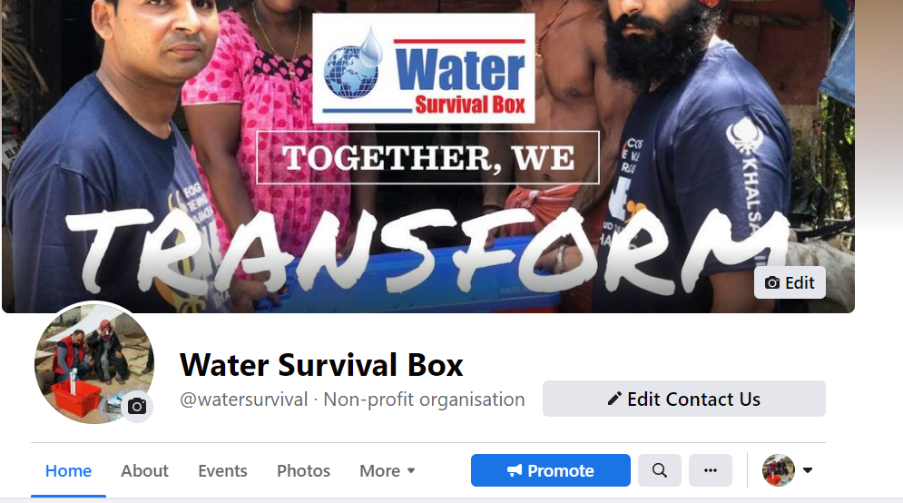

Slide 20
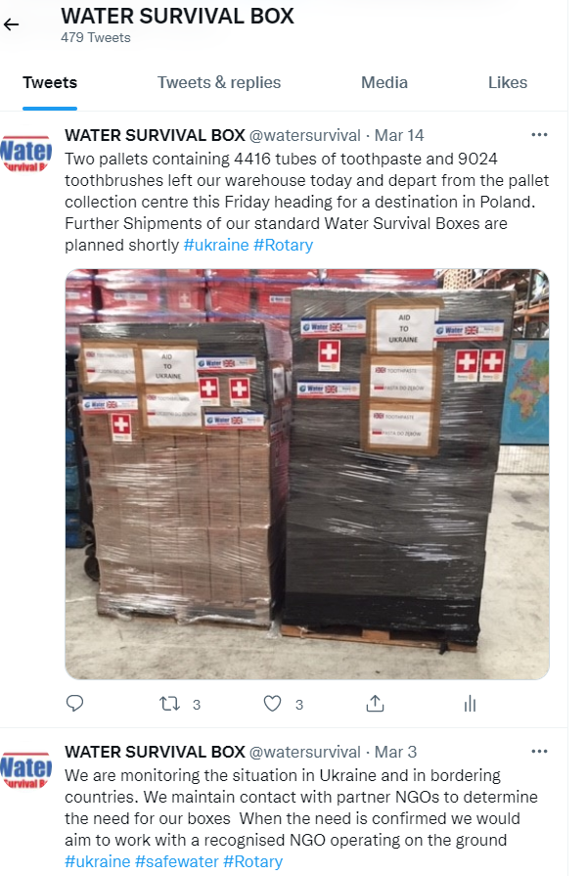

Slide 21
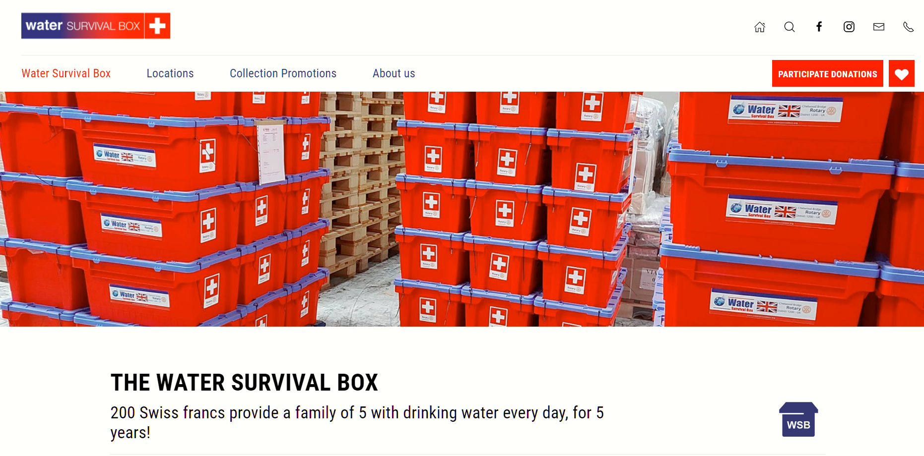
Notes:
Our Swiss Rotary partners who provide a lot of income. They currently pay for about 50 % of boxes leaving us . We meet with their board every 2 months to share news.

Slide 22
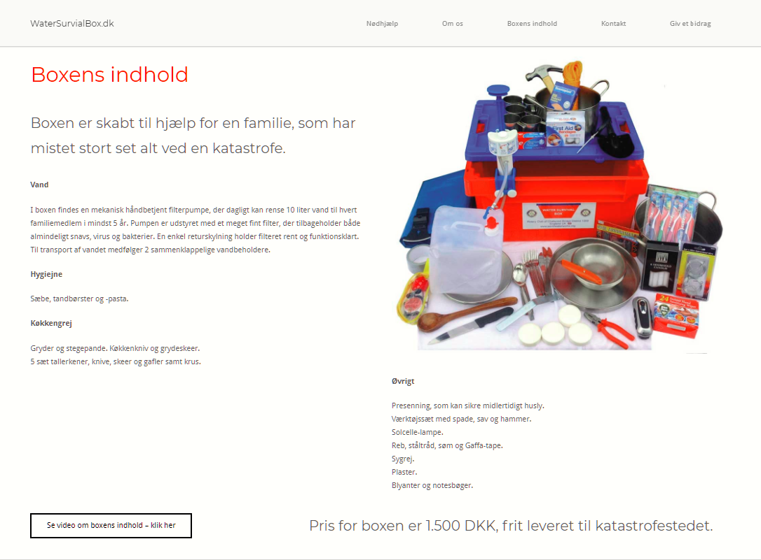
Notes:
We also have rotary partners in Denmark who are also generous supported in fund raising for us

Slide 23

£150

Slide 24
YOUR SUPPORT WILL TRANFORM MANY LIVES
Saving Lives through Clean Water
More information at
https://watersurvivalbox.org
Notes:
The cost of the box is £200 which includes airfreight wherever possible and with no paid staff our overheads are very low which means that your donation goes a very long way
More information at
watersurvivalbox.org

